Slide 1


Want To Be Rich?

Slide 2

Dive into Stock Market

Slide 3







Companies in Silicon Valley

Slide 4


Tool We Want

Slide 5
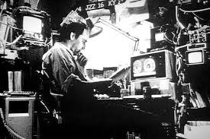
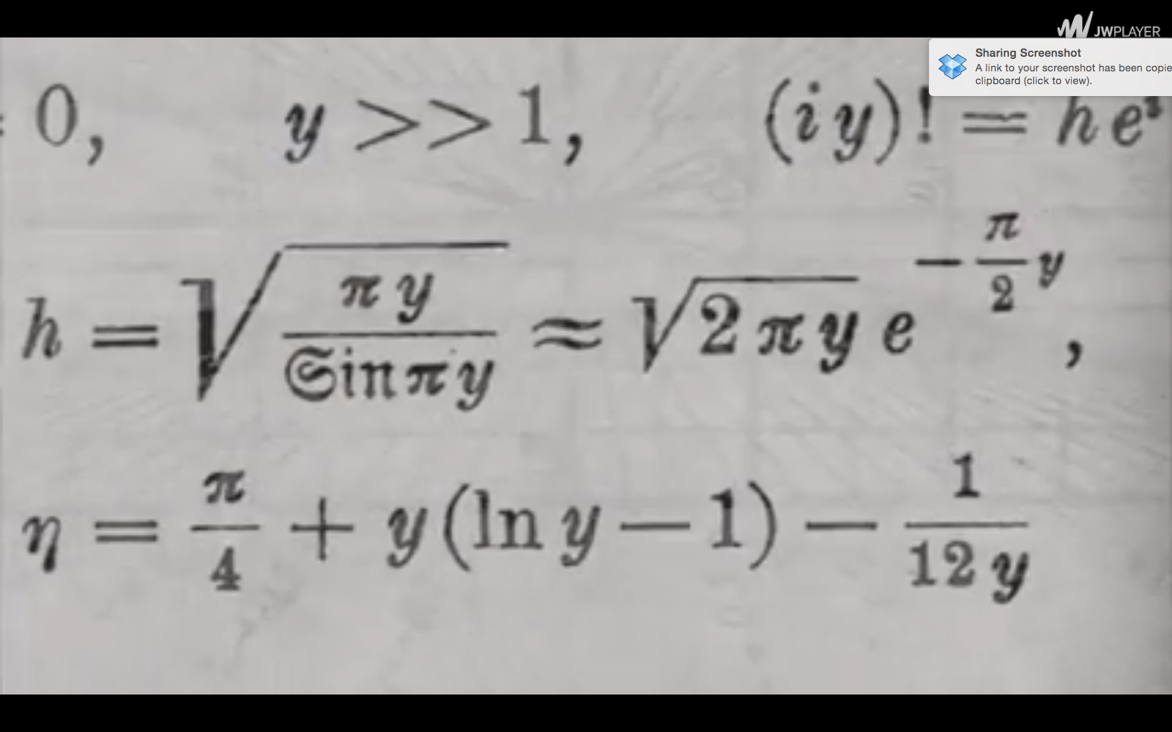
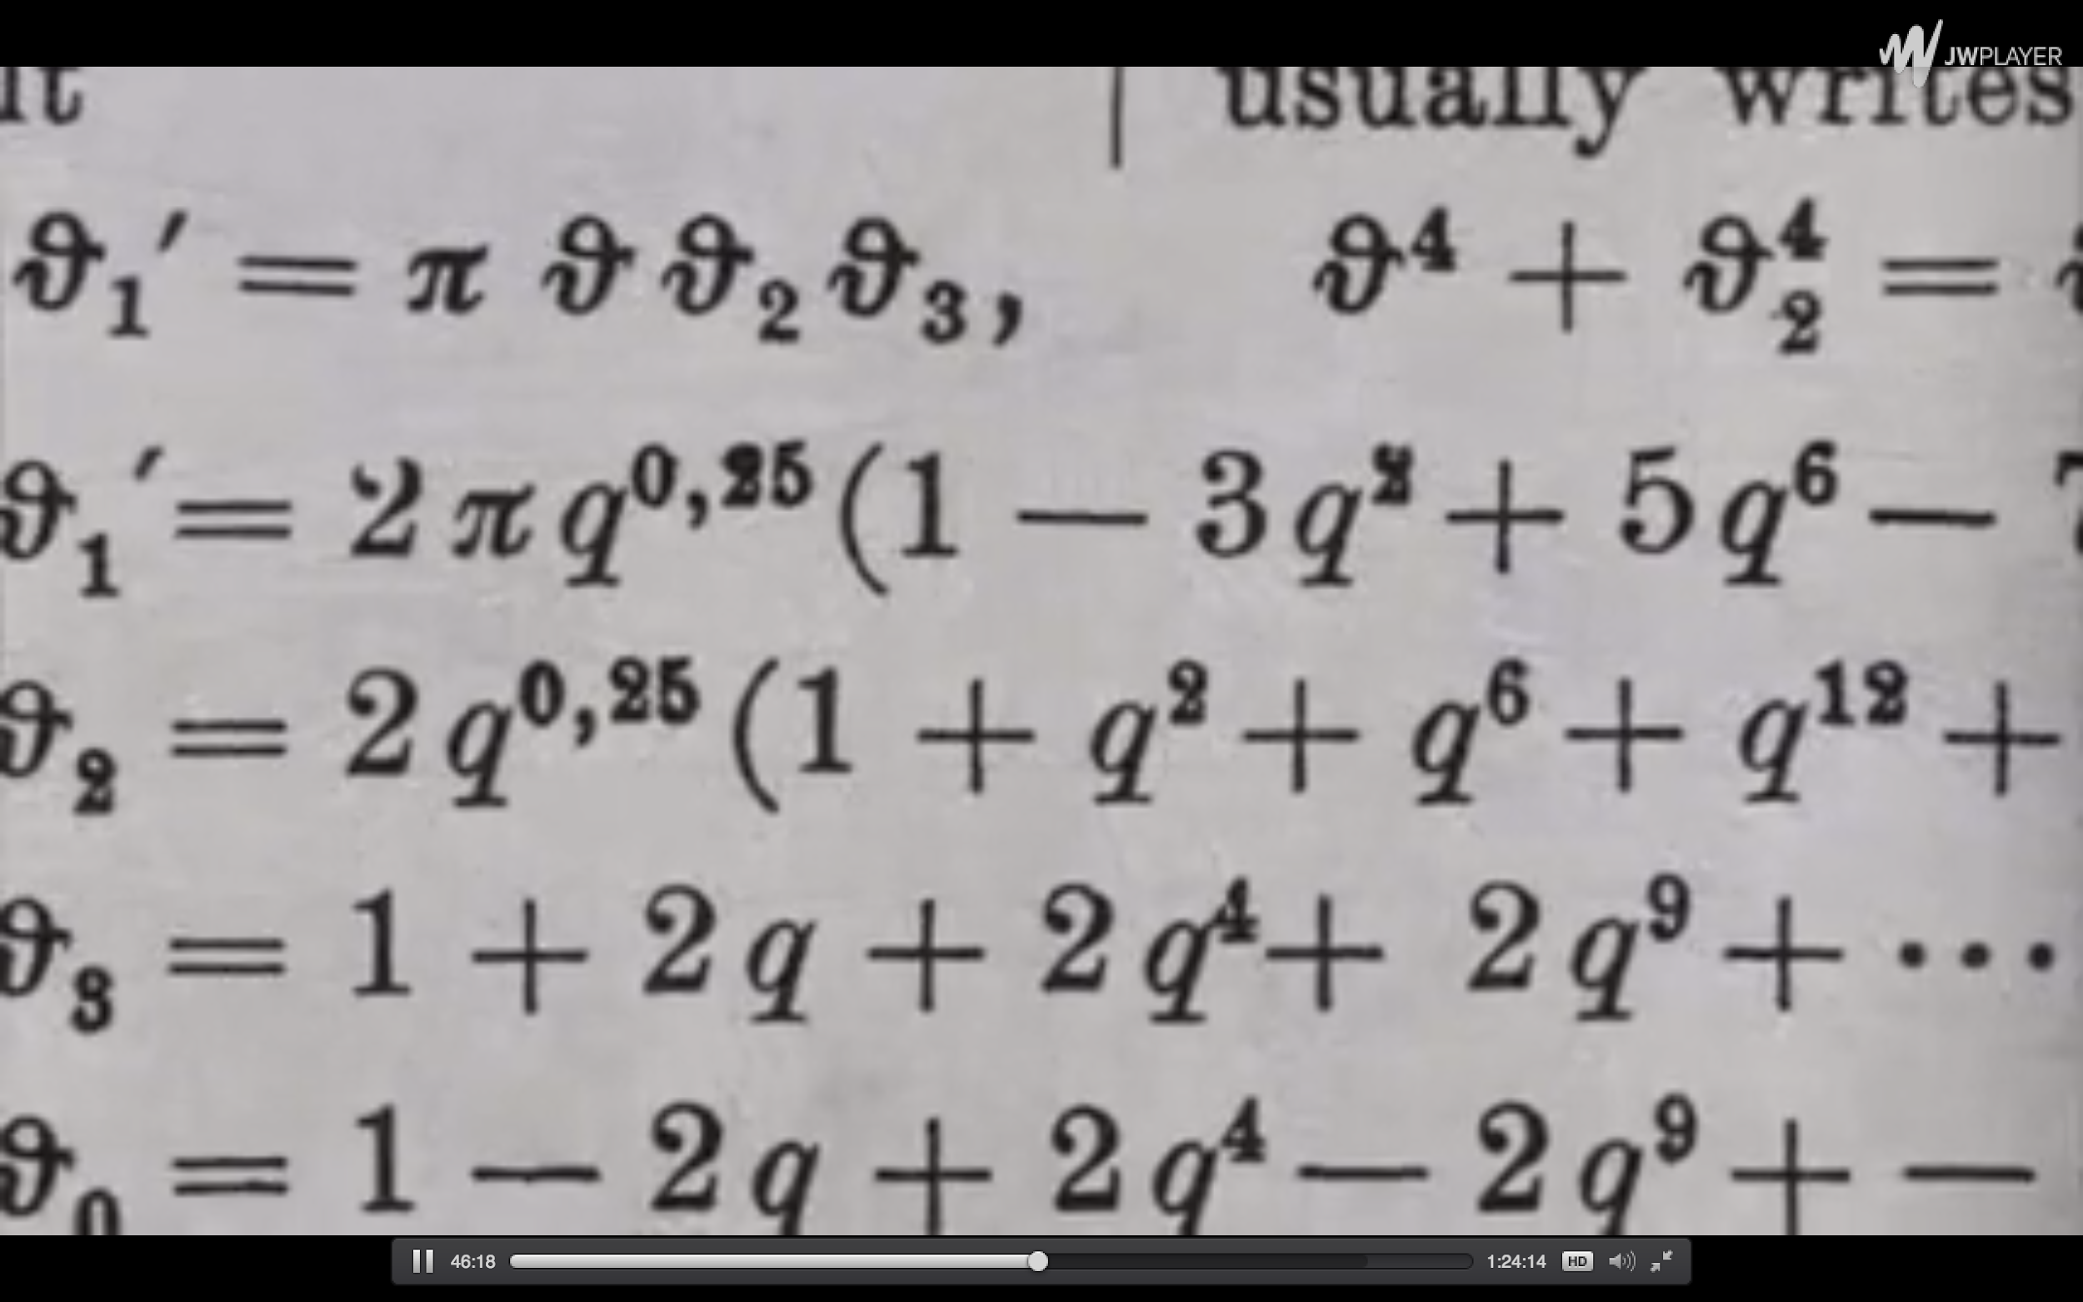
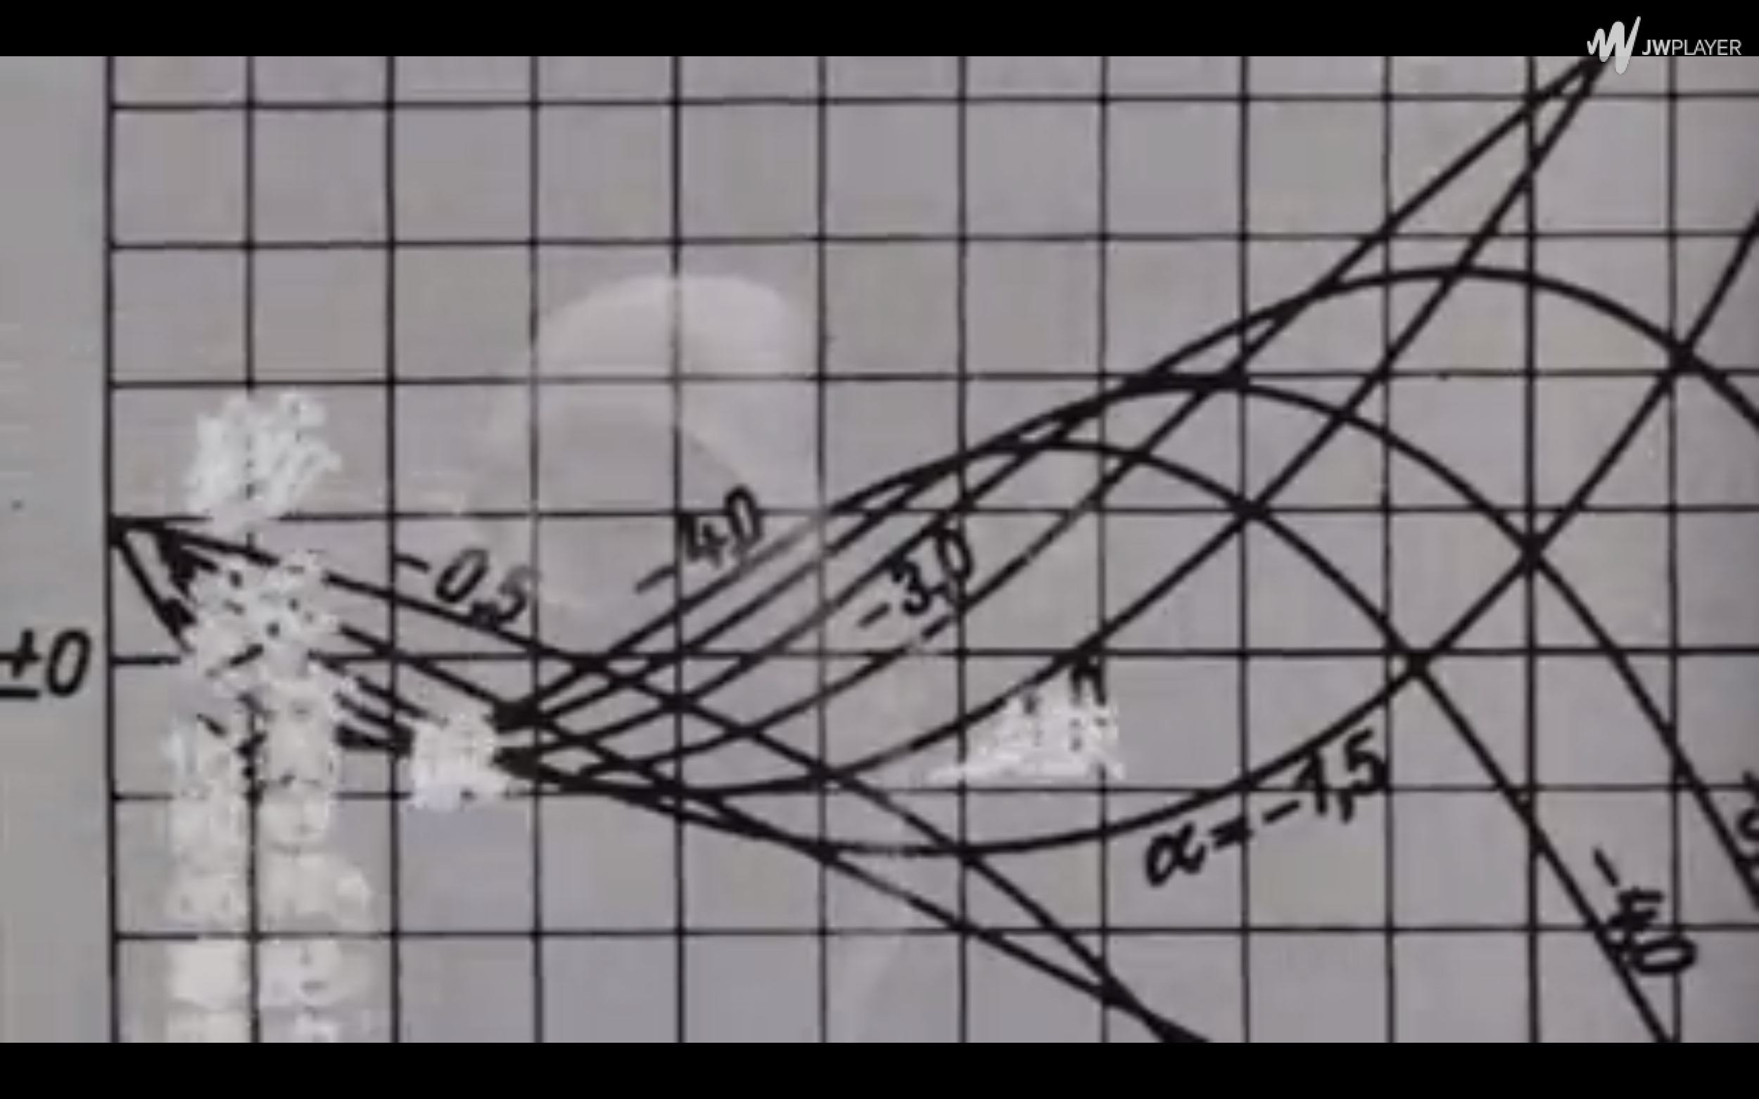
Assumptions

Slide 6
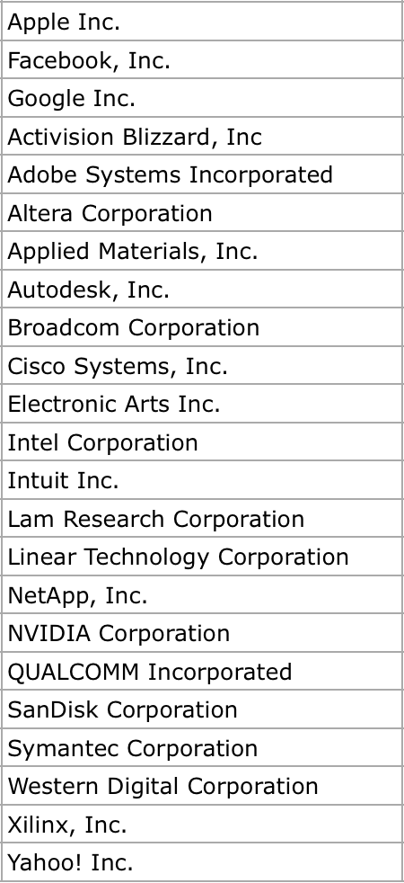
Datasets
NASDAQ → California
→ Technology
→ Large and Mega Cap
25 Companies
Past 5 years
Train: Test = 9: 1

Slide 7

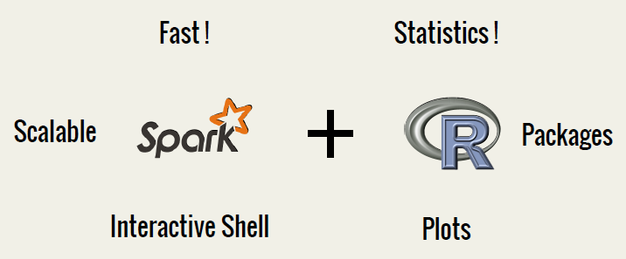
Best Friend
Package
acf
lm
arma
arima
forecast
tseries
accuracy

Slide 8
Models
Polynomial
Seasonal
Holt-Winter Filter
Exponential Smoothing
ARIMA
ARIMA Seasonal
Neural Networks
Advanced Linear Model

Slide 9
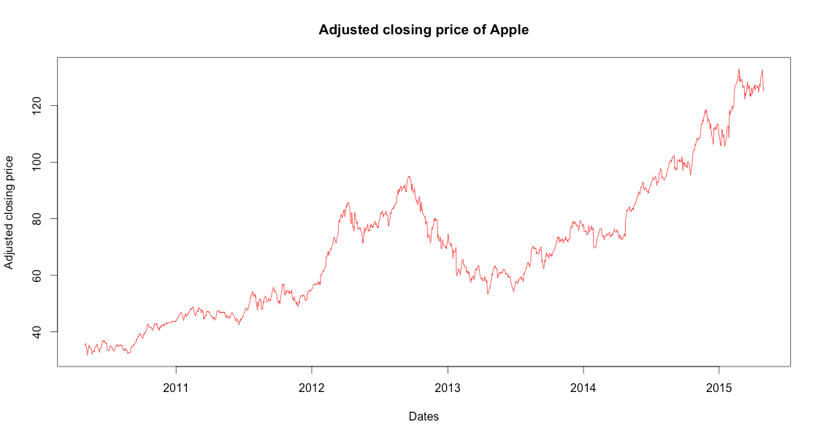
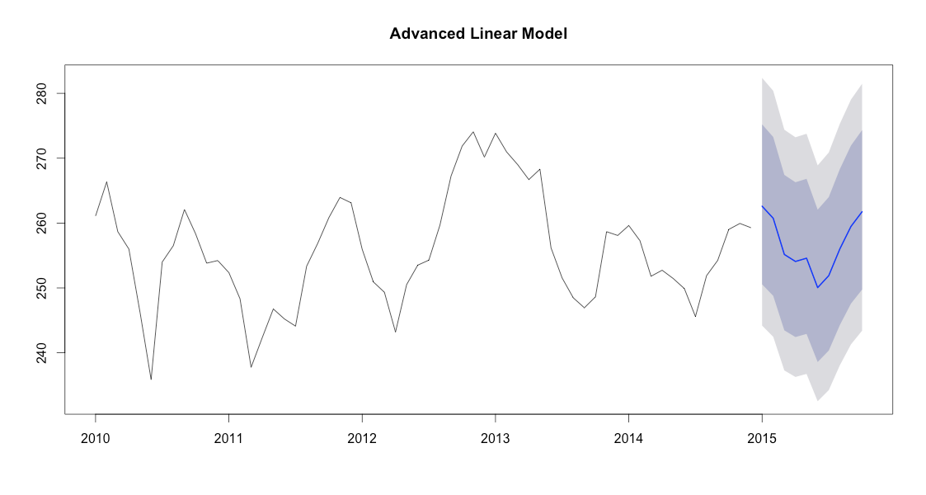
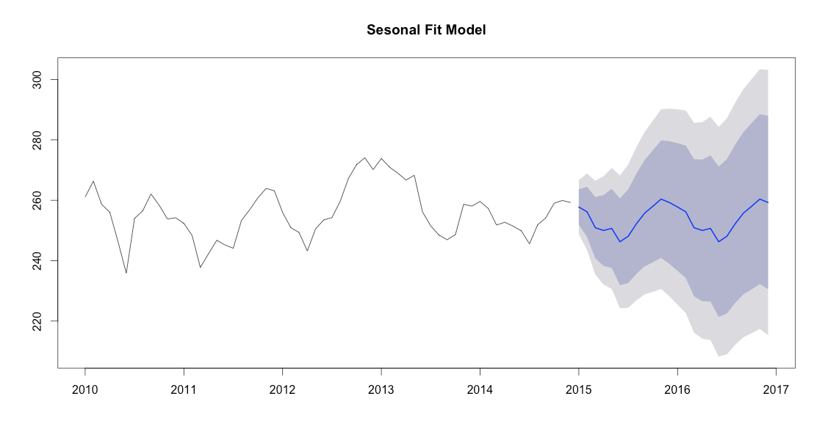
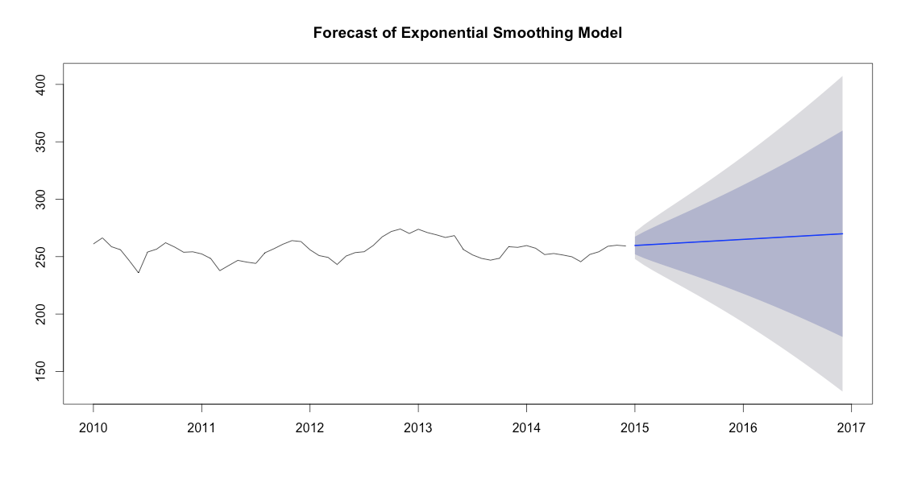
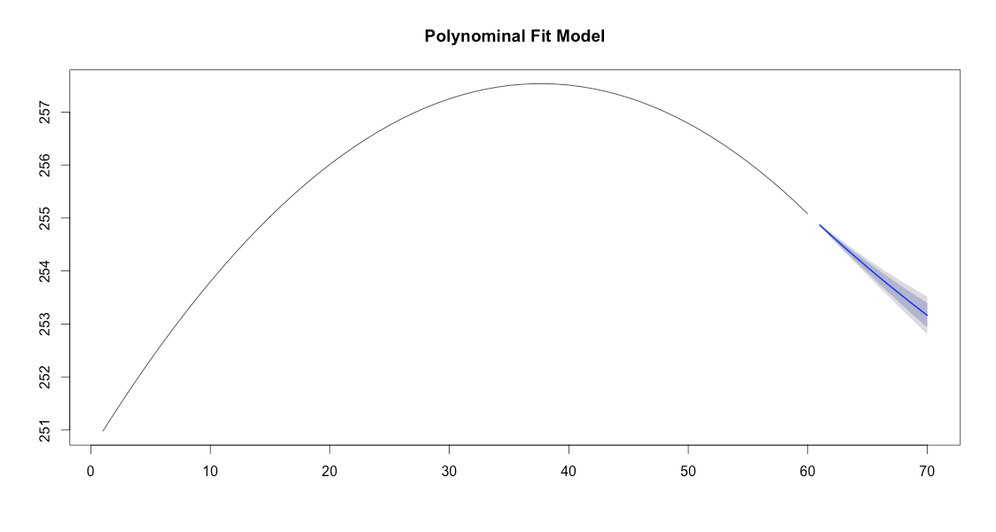
Quick Comparison

Slide 10
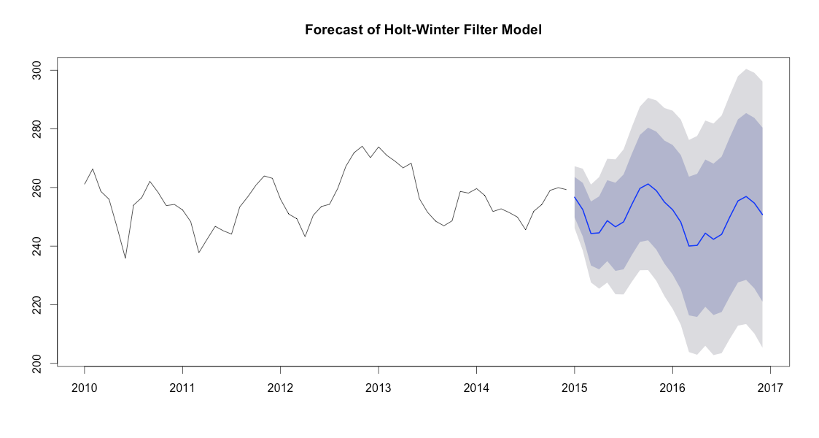
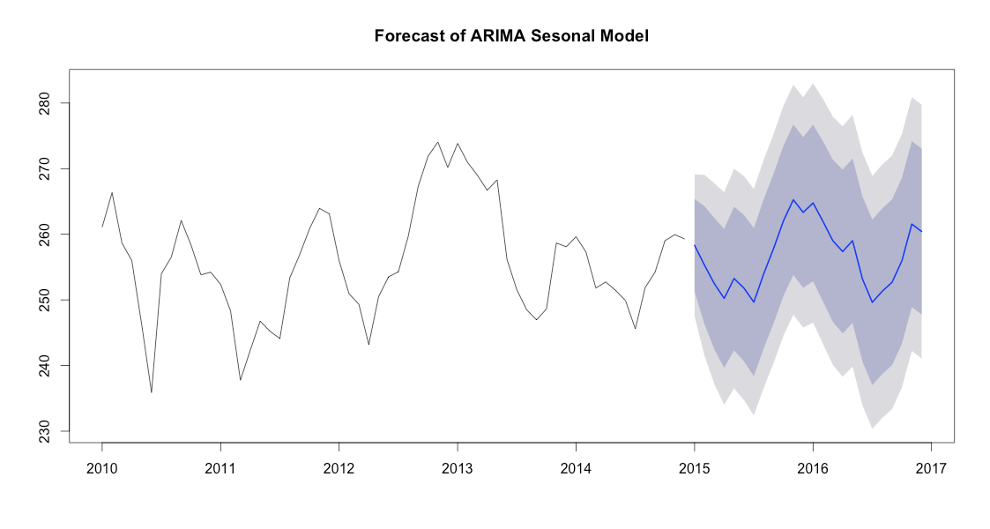
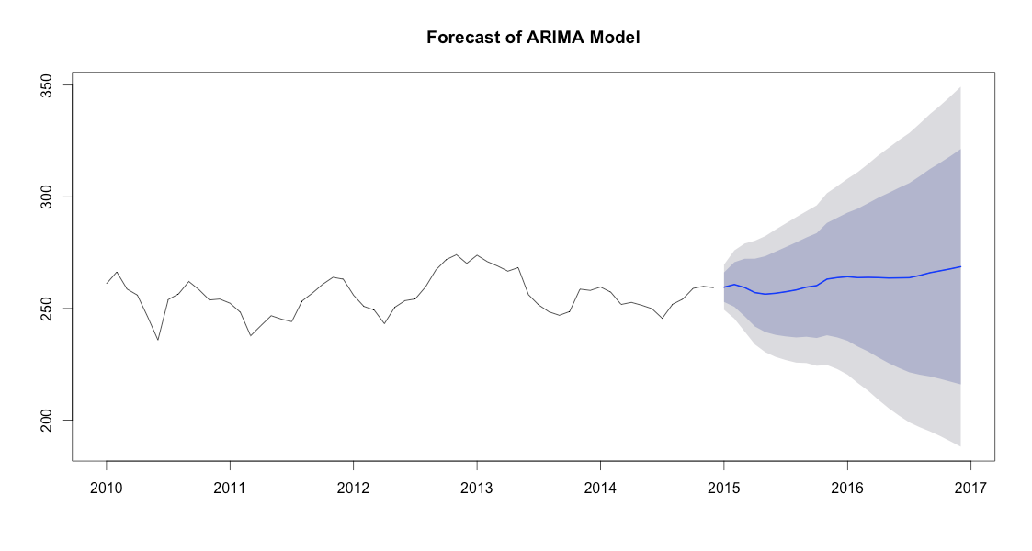
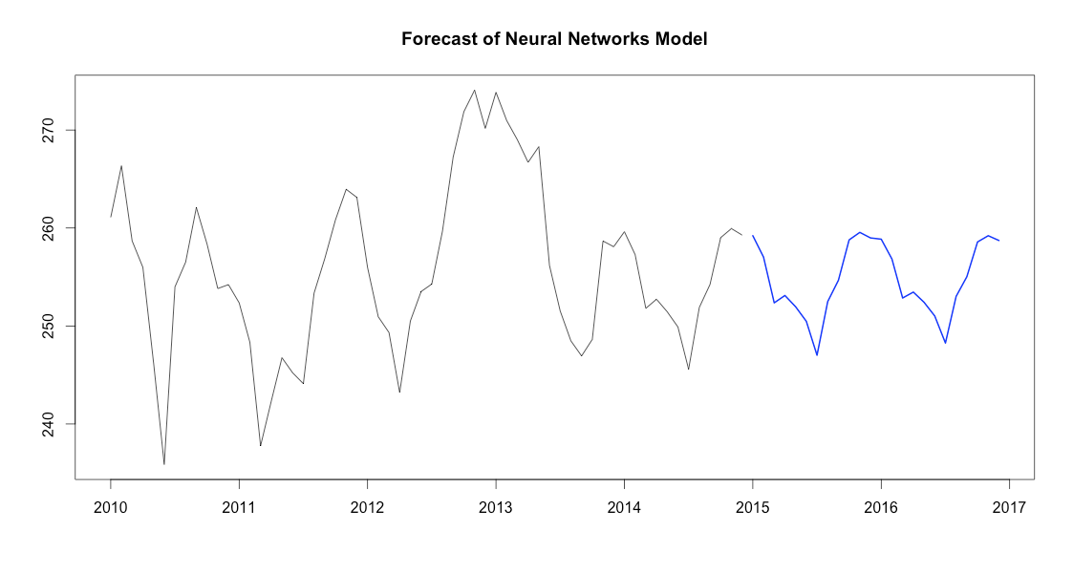
Quick Comparison Cnt

Slide 11

But Which Model??

Slide 12



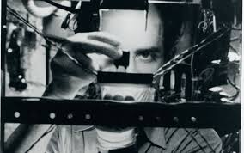
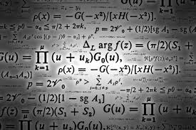
Happy Birthday Euclid

Slide 13

Demo
Git Repo: https://github.com/gyoho/stock-market-prediction

Slide 14

Want To Be Serious?

Slide 15
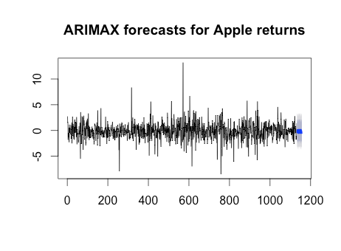
Return in The Future

Slide 16
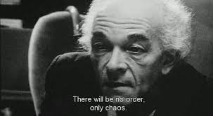
Conclusion
Stock Market Prediction is Hard...

